Slide 1

GEOG 3319: Geographic Field Techniques
Lecture 06 Future and Application of GNSS
Yaqian He, PhD
Assistant Professor
Department of Geography

Slide 2

Overview
GNSS Family
GPS
GLONASS
Galileo
BeiDou
QZSS
IRNSS
Why GNSS?
GNSS Application

Slide 3
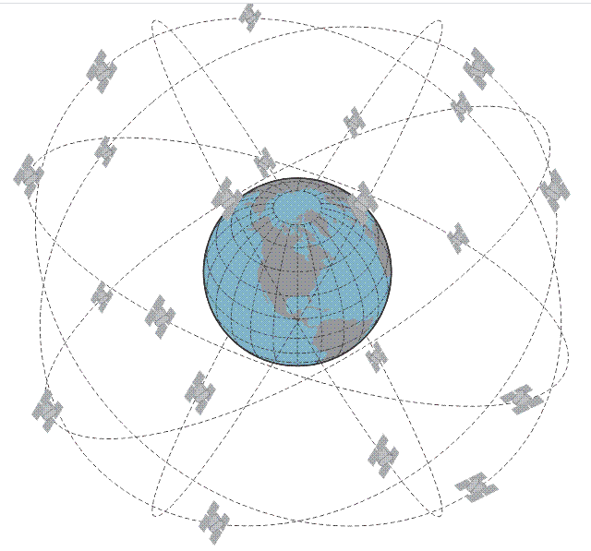
GPS
1978
6 Orbital planes
MEO
24 Satellites (currently 31)
55° Inclination Angle
Altitude 20, 200 km
½ sidereal day period
https://www.e-education.psu.edu/geog862/node/1860
Notes:
1993, 24 satellites
Ascending node
23h56min, solar day is 24 hours

Slide 4
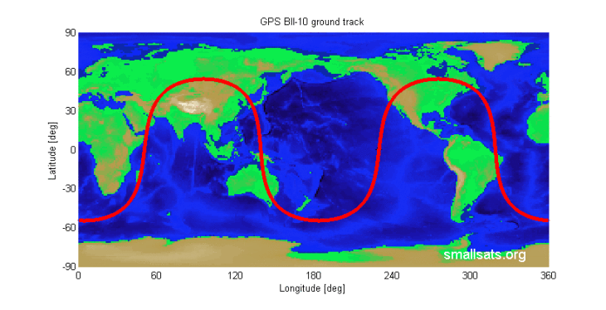
GPS
GPS Ground Track
The vertical projection of the satellite's orbit onto the surface of the Earth
https://smallsat.files.wordpress.com/2013/01/issgroundtrack_011.png
Notes:
1993, 24 satellites

Slide 5
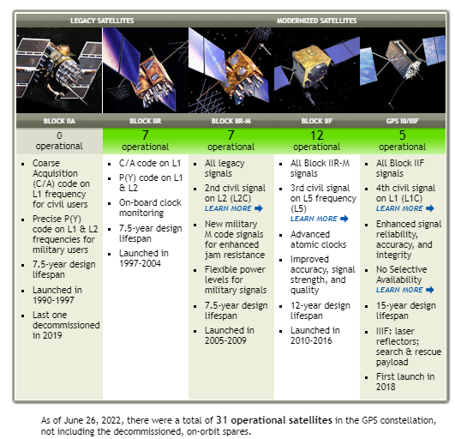
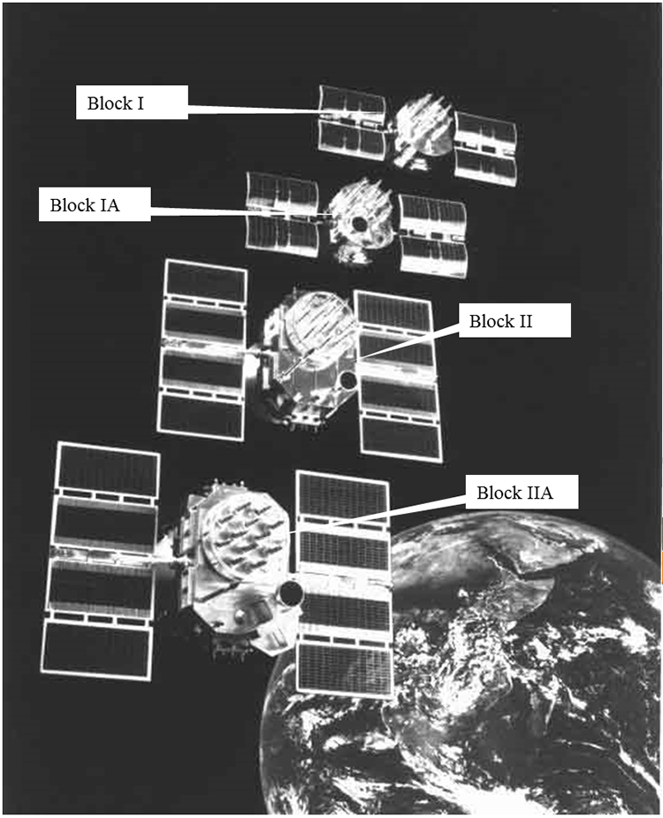
GPS
GPS satellite
https://www.gps.gov/systems/gps/space/#:~:text=The%20satellites%20in%20the%20GPS,any%20point%20on%20the%20planet
https://www.e-education.psu.edu/geog862/node/1860
Notes:
1993, 24 satellites, last year is 34, now is 31

Slide 6
GPS
Present and future GPS signal
Block I (1978-1985): L1 (C/A), L1 and L2 (P-code)
Block IIR-M (2005-2009): L2 (L2C), L1 and L2 (M-code), L5
Block IIF (2010-2016): Civil code on L5
Block III (2018-): L1C
Notes:
BOC: Binary offset carrier modulation
Reduce error rate, more flexible, less code noise, improve the L1 Civil signal

Slide 7
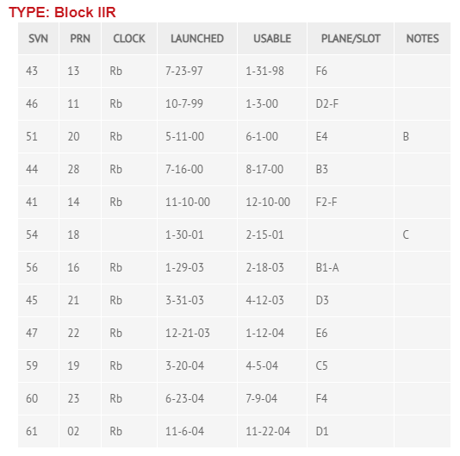
GPS
GPS Almanac
SV Number: refers to space vehicle number.
PRN Number: refers to the satellite’s unique pseudorandom noise code.
Clock: Rb = rubidium; Cs = cesium.
Launched and Usable dates: are based on Universal Time.
https://www.gpsworld.com/the-almanac/
Notes:
BOC: Binary offset carrier modulation
The current active GPS constellation consists of 1 Block IIA, 11 Block IIRs, 7 Block IIR-Ms and 12 Block IIFs for a total of 31 satellites and is under FOC (Full Operational Capability).

Slide 8
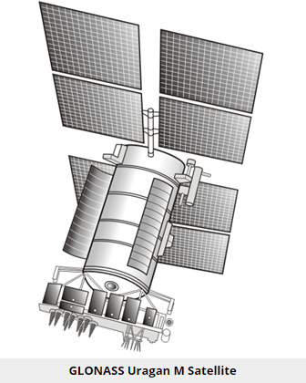
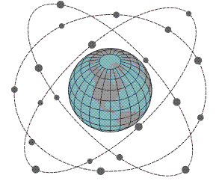
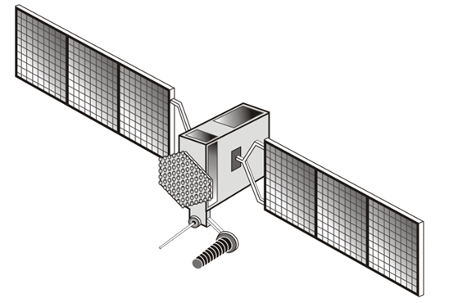
GLONASS
1982
3 Orbital planes
MEO
1996, 21 Satellites + 3 Spares (currently 24)
64.8 ° Inclination Angle
Altitude 19, 100km
8/17 sidereal day period
https://www.e-education.psu.edu/geog862/node/1872
Notes:
Only 7 healthy satellites remained in 2001. After that, a program to rebuild and modernize GLONASS.
It is higher than GPS
https://en.wikipedia.org/wiki/GLONASS

Slide 9
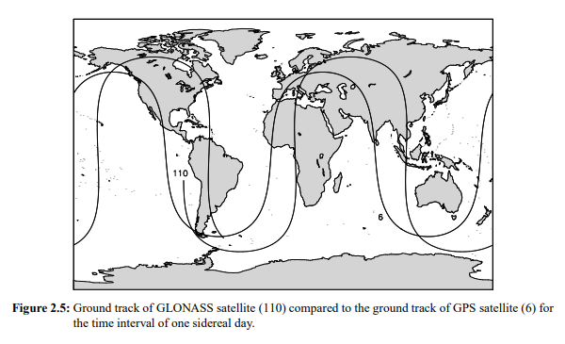
GLONASS
GPS vs GLONASS Ground Track
GLONASS
GPS
http://ftp.aiub.unibe.ch/BERN42/DOCU/DOCU42_2.pdf

Slide 10
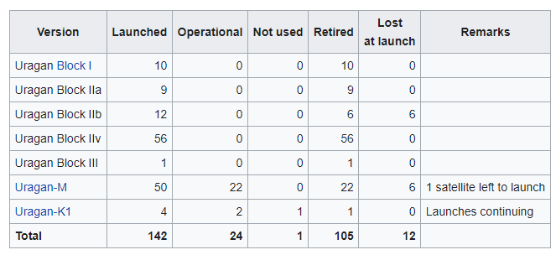
GLONASS
GLONASS satellite
https://en.wikipedia.org/wiki/List_of_GLONASS_satellites
Notes:
Last year 24

Slide 11
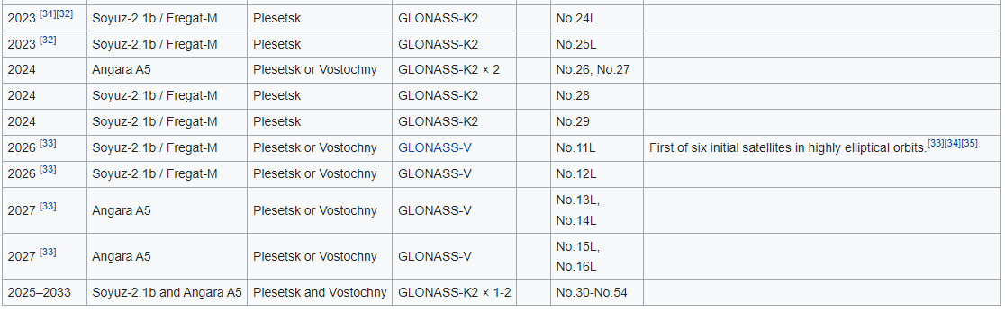
GLONASS
GLONASS future plan
https://en.wikipedia.org/wiki/List_of_GLONASS_satellites
Notes:
1993, 24 satellites

Slide 12
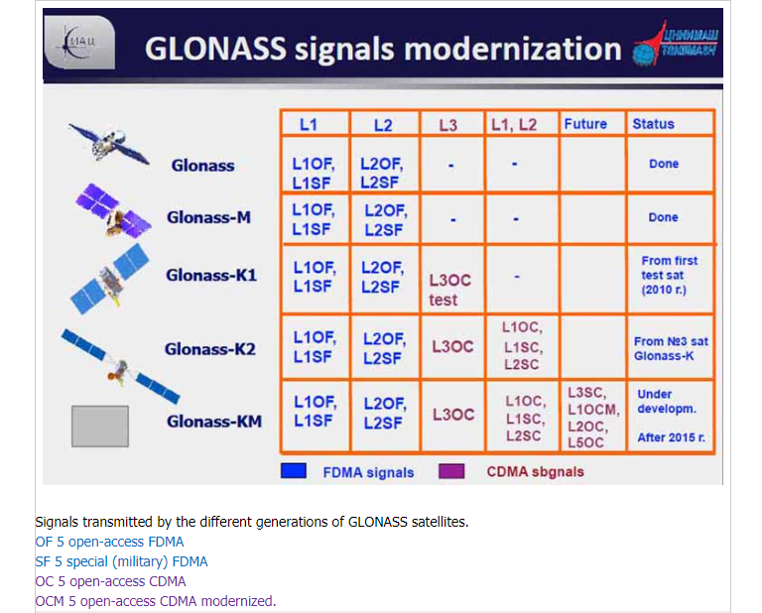
GLONASS
Present and future GLONASS signal
https://www.e-education.psu.edu/geog862/node/1874
Notes:
GLONASS has only one PRN code, starting for GLONASS-K, it will be more like GPS code.
BOC: Binary offset carrier modulation, more like GPS code
FDMA (Frequency Division Multiple Access); This approach is known as CDMA (Code Division Multiple Access)
The first is L1 (~1602 MHz), in which the separation between individual carriers is 0.5625 MHz; the range is between ~1598.0625 to ~1607.0625 MHz. The second is L2 (~1246 MHz), in which the separation between individual carriers is 0.4375 MHz; the range is between ~1242.9375 to ~1249.9375 MHz. The third is L3. This third civil signal on L3 is available on the K satellites and within a new frequency band (~1201 MHz) that includes 1201.743 to 1208.511 MHz and will overlap Galileo’s E5B signal.
The open signal L3OC is centered at 1202.025 MHz and uses BPSK(10) modulation for both data and pilot channels; the ranging code transmits at 10.23 million chips per second, modulated onto the carrier frequency using QPSK with in-phase data and quadrature pilot.

Slide 13
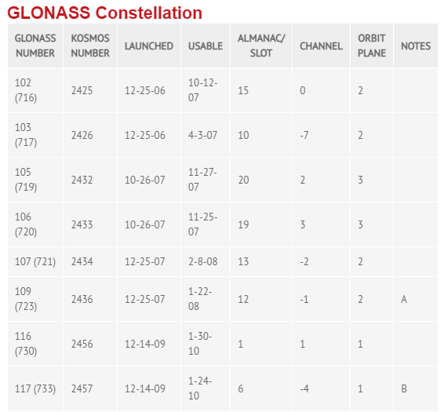
GLONASS
GLONASS Almanac
The Russian Federation designated the Kosmos Number.
Channel number k indicates L1 and L2 carrier frequencies: L1 = 1,602 + 0.5625 k (MHz); L2 = 1,246 + 0.4375 k (MHz).
All launch and usable dates are based on Moscow Time (Universal Time + 3 hours).
https://www.gpsworld.com/the-almanac/
Notes:
The Russian Federation designated the “Kosmos Number.”
Channel number “k” indicates L1 and L2 carrier frequencies: L1 = 1,602 + 0.5625 k (MHz); L2 = 1,246 + 0.4375 k (MHz).

Slide 14
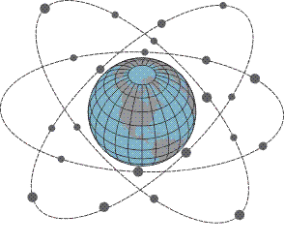
Galileo
2005
3 Orbital planes
MEO
30 satellite (currently 24， as of December 2021)
56° Inclination Angle
Altitude 23, 222 km
10/17 sidereal day period
https://www.e-education.psu.edu/geog862/node/1876
Notes:
1993, 24 satellites, inclination maybe changed
Two Galileo sent to wrong orbits

Slide 15
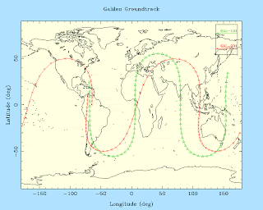
Galileo
Galileo Ground Track
http://positimgnss.blogspot.com/2014/08/groundtrack-of-galileo-satellites.html
Notes:
The figures shows the ground track of Galileo-101 (E11), one of the older Galileo satellites, and Galileo-201, one of the two new Galileo satellites, over a period of 24 hours for August 23, 2014. A couple of interesting features can be seen from the plot. Firstly the difference in inclination, 56 vs 49 degrees, is clearly visible as the maximum latitude of the Galileo-201 satellite is clearly smaller.

Slide 16
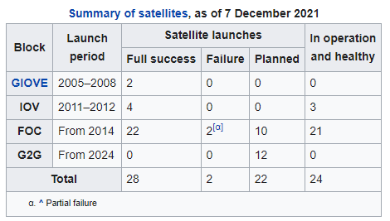
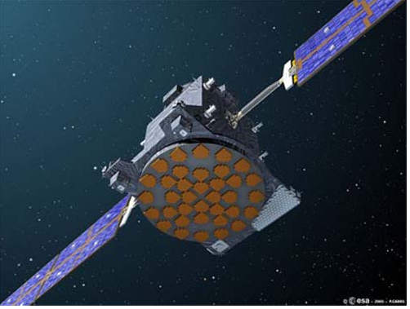
Galileo
Galileo satellite
https://en.wikipedia.org/wiki/Galileo_(satellite_navigation)
https://www.e-education.psu.edu/geog862/node/1876

Slide 17
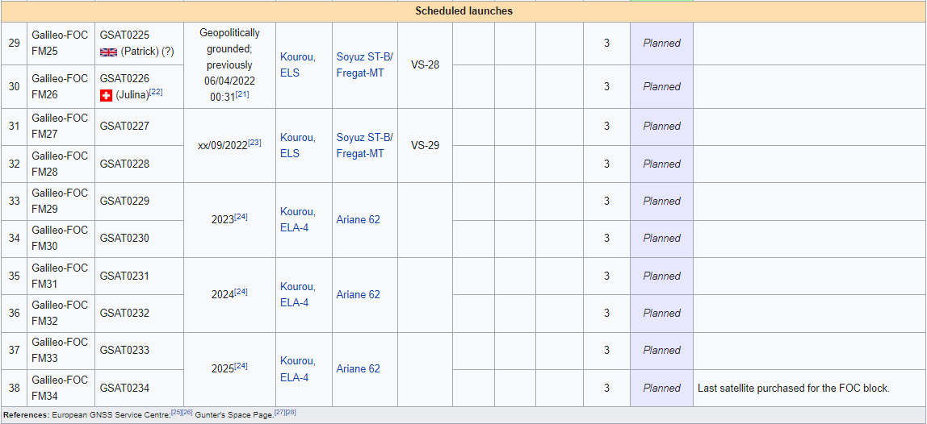
Galileo
Galileo future plan
https://en.wikipedia.org/wiki/List_of_Galileo_satellites
Notes:
1993, 24 satellites

Slide 18
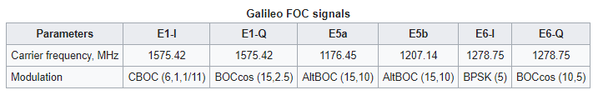
Galileo
Present and future Galileo signal
https://en.wikipedia.org/wiki/Galileo_(satellite_navigation)
Notes:
BOC: Binary offset carrier modulation, copy GPS system. L1 and L5
Full Operational Capability
Therefore, BPSK-modulated signals such as C/A GPS codes have most of their spectral energy concentrated around the carrier frequency, while BOC-modulated signals (used in Galileo system) have low energy around the carrier frequency and two main spectral lobes further away from the carrier (thus, the name of split-spectrum). https://en.wikipedia.org/wiki/Binary_offset_carrier_modulation

Slide 19
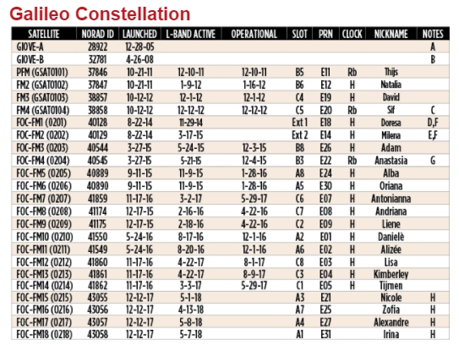
Galileo
Galileo Almanac
NORAD ID is assigned by USSPACECOM to all Earth orbit satellites in order of identification.
https://www.gpsworld.com/the-almanac/#galileo
Notes:
Satellites launched into wrong orbits.
Orbit perigree raised by about 3500 kilometers in November 2014.
Clock failures in 2017

Slide 20
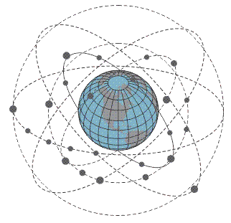
Beidou
2000
7 Orbital planes (3 MEO+1GEO+3IGSO)
44 Satellites (27 MEO, 7 GEO, and 10 IGSO)
55° Inclination Angle
7/13 sidereal day period
Altitude 21, 500 km
https://www.e-education.psu.edu/geog862/node/1879
Notes:
Initiated 1994
inclined geosynchronous orbits (IGSO)
June, 2020
The IGS01, IGS02 and IGS03 satellite are at ~120°E. IGS04 and IGS05 are at ~95°E.
https://gssc.esa.int/navipedia/index.php/BeiDou_Space_Segment

Slide 21
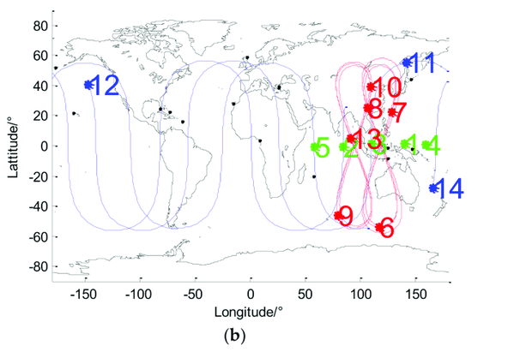
Beidou
Beidou Ground Track
https://www.researchgate.net/figure/Ground-tracks-of-Global-Positioning-System-GPS-satellites-Beidou-Satellite-Navigation_fig1_325124152
Notes:
1993, 24 satellites, sinusoid, symmetric

Slide 22
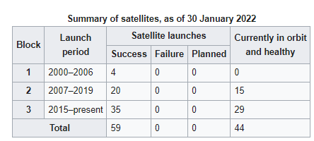
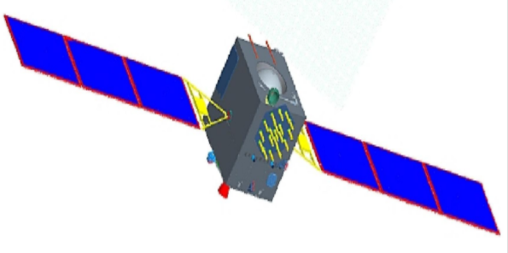
Beidou
Beidou satellite
https://directory.eoportal.org/web/eoportal/satellite-missions/content/-/article/cnss
https://en.wikipedia.org/wiki/Global_Positioning_System
Notes:
1993, 24 satellites

Slide 23
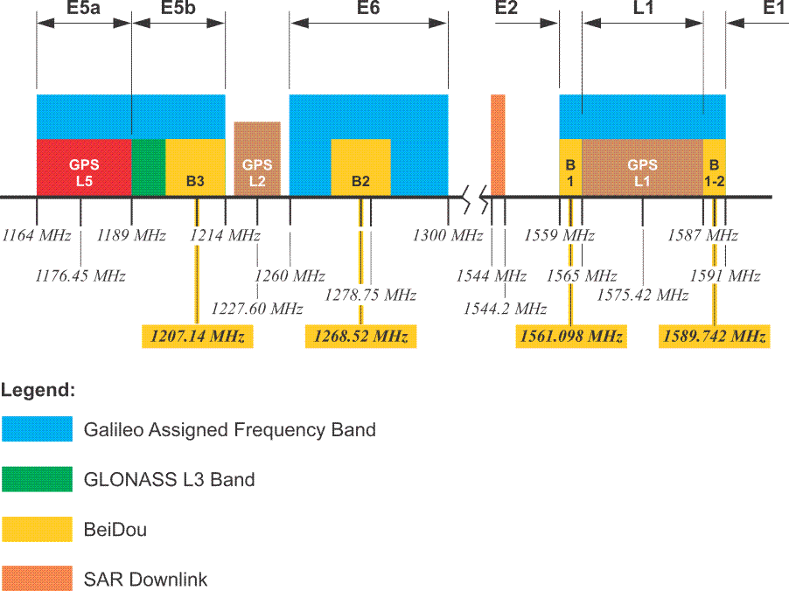
Beidou
Beidou signal
https://www.e-education.psu.edu/geog862/node/1879
Notes:
BOC: Binary offset carrier modulation
BeiDou satellites currently transmit signals in three bands; B1 (1561.098 MHz), B1-2 (1589.742 MHz), B2 (1207.14 MHz) and B3 (1268.52). The modulation scheme is quadraphase shift key (QPSK)

Slide 24
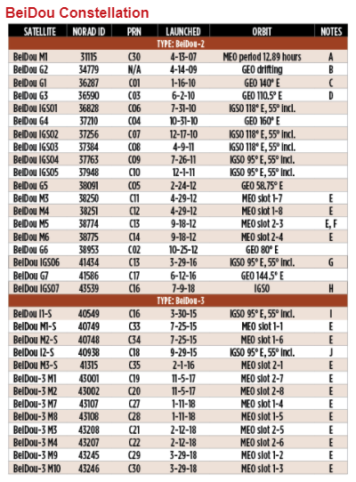
Beidou
Beidou Almanac
https://www.gpsworld.com/the-almanac/
Notes:
BOC: Binary offset carrier modulation
1OV test satellite, but in operation
GEO, formerly at 84° E, shifted to 110.5° E between about Nov. 7 and Nov. 23, 2012.
Satellite is not currently transmitting standard signals.

Slide 25
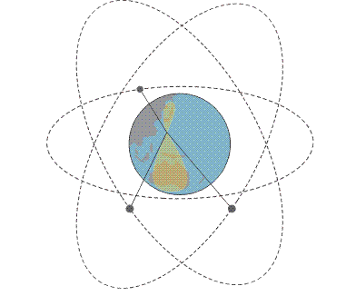
QZSS (Quasi-Zenith Satellite System)
2010
4 Orbital planes (3 IGSO and 1 GEO)
GEO
7 Satellites (currently 4)
40° Inclination Angle
Altitude 32, 000 – 40,000 km
1 sidereal day period
https://www.e-education.psu.edu/geog862/node/1880
Notes:
10 years design life, Quasi-Zenith Satellite System (QZSS), in the sbas page

Slide 26

QZSS
Ground Track
https://www.e-education.psu.edu/geog862/node/1880

Slide 27
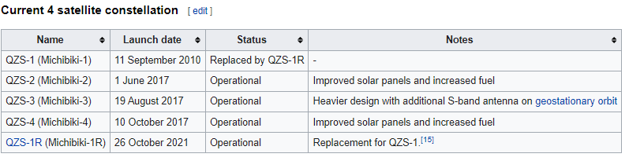
QZSS
QZSS satellite
https://en.wikipedia.org/wiki/Quasi-Zenith_Satellite_System
Notes:
1993, 24 satellites

Slide 28
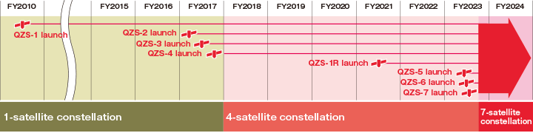
QZSS
QZSS future plan
https://qzss.go.jp/en/overview/services/sv01_what.html
Notes:
1993, 24 satellites

Slide 29
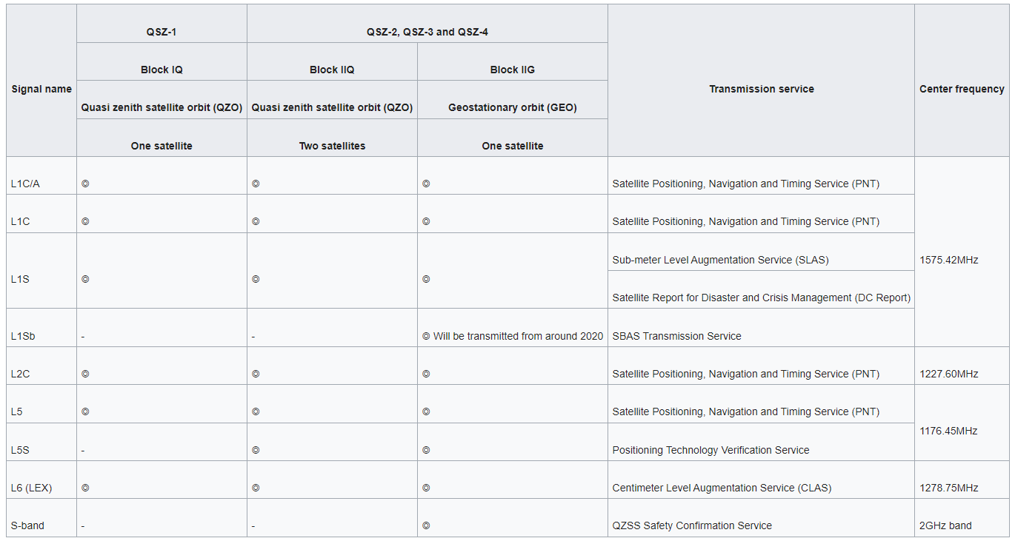
QZSS
Present and future QZSS signal
https://gssc.esa.int/navipedia/index.php/QZSS
Notes:
The system transmits 6 signals, L1-C/A, L1C. L2C, L5 are similar with GPS siganal
Navigation and Timing Service

Slide 30

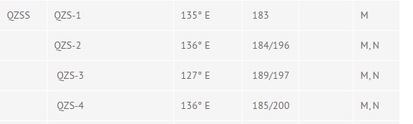
QZSS
QZSS Almanac
https://www.gpsworld.com/the-almanac/#SBAS
Notes:
N. On June 2, 2018, QZS-3 suffered a signal amplifier switch failure. During trouble shooting, all test signals from QZS-2, QZS-3 and QZS-4 have been temporally halted since June 4, 2018

Slide 31
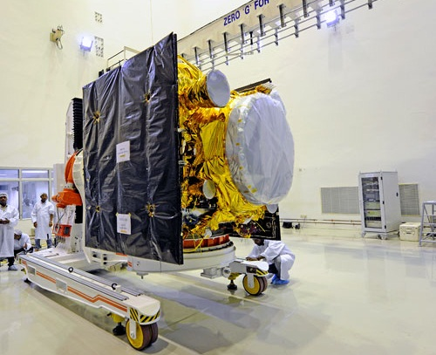
IRNSS (Indian Regional Navigation Satellite System)
2013
3 Orbital planes (1 IGSO and 2 GEO)
GEO
2018, 7 Satellites
29° Inclination Angle
Altitude 35,700 km
1 sidereal day period
https://spaceflight101.com/spacecraft/irnss/
Notes:
2006 planed, Indian Regional Navigation Satellite System, 3 GEO satellite and 4 GSO satellite, 9.5 -11 years , 2 spare are also planed
Altitude 35,700 km (GEO)

Slide 32
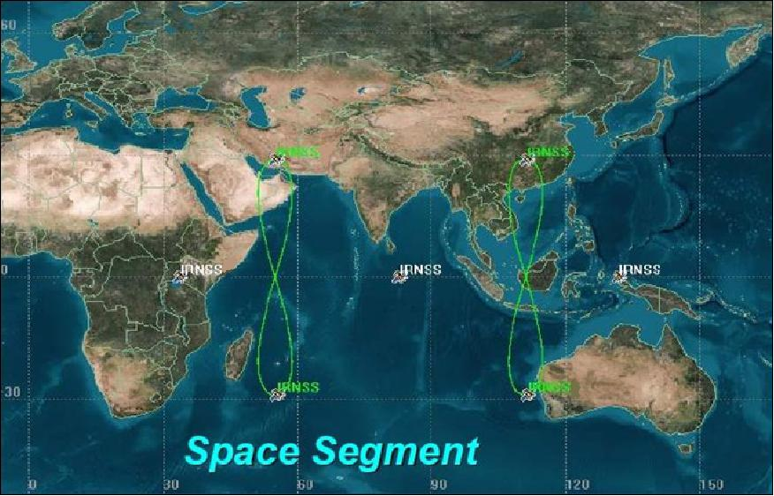
IRNSS
Ground Track
https://directory.eoportal.org/web/eoportal/satellite-missions/content/-/article/irnss

Slide 33
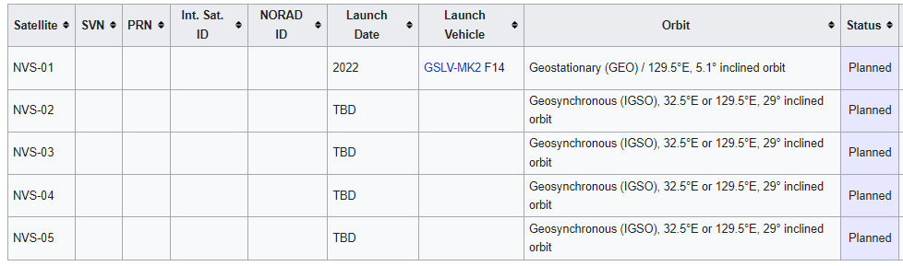
IRNSS
IRNSS future plan
https://en.wikipedia.org/wiki/Indian_Regional_Navigation_Satellite_System
Notes:
1993, 24 satellites

Slide 34
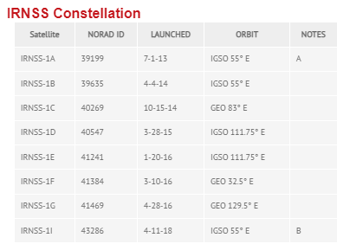
IRNSS
IRNSS satellite
IRNSS Almanac
https://www.gpsworld.com/the-almanac/
Notes:
A. Decommissioned.

Slide 35
IRNSS
Present and future IRNSS signal
L5 (1176.45 MHz)
S band (2492.028 MHz)
Standard Positioning Service and Precision Service
Notes:
Binary offset carrier modulation
NavIC signals will consist of a Standard Positioning Service and a Precision Service. Both will be carried on L5 (1176.45 MHz) and S band (2492.028 MHz).^{[54]} The SPS signal will be modulated by a 1 MHz BPSK signal.

Slide 36
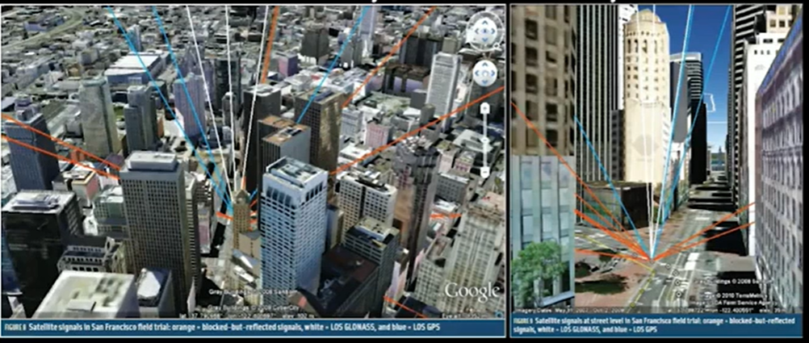
Why GNSS?
Availability for Accuracy
Stanford University
Notes:
BOC: Binary offset carrier modulation

Slide 37
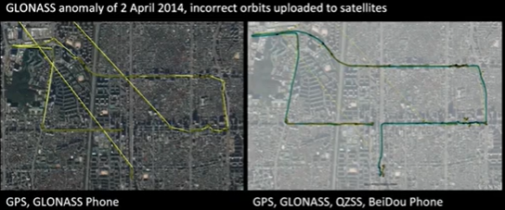
Why GNSS?
Availability for Robustness
Stanford University
Notes:
BOC: Binary offset carrier modulation

Slide 38
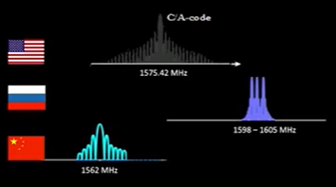
Why GNSS?
Jamming immunity
Stanford University
Notes:
BOC: Binary offset carrier modulation

Slide 39
GNSS Application
Availability for Accuracy
Consumer
Ground Mapping
Transportation
GIS
Machine Control
Port Automation
Precision Agriculture
Timing
Construction
Marine
Unmanned Vehicles
Surveying
Defense
Aerial Photogrammetry
Notes:
BOC: Binary offset carrier modulation

Slide 40


GNSS Application
https://www.engineering.com/BIM/ArticleID/18792/The-Rest-of-the-Industrialized-World-Has-High-Speed-Rail-Why-Cant-the-US.aspx
Notes:
BOC: Binary offset carrier modulation

Slide 41

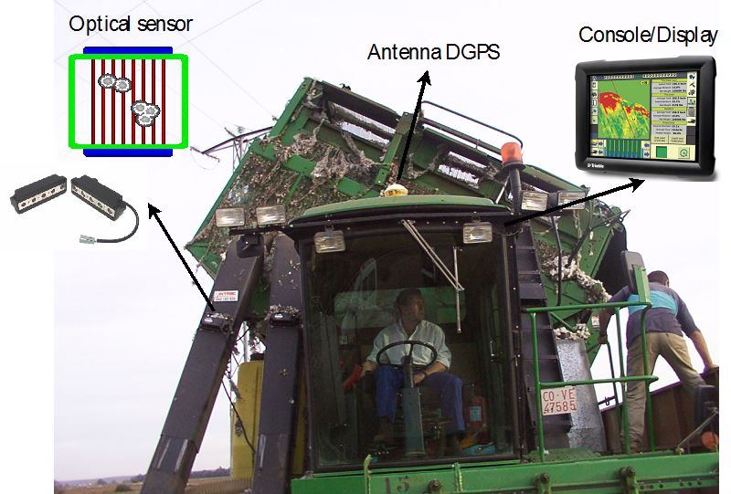
GNSS Application
https://www.sohu.com/a/417142570_188923?spm=smpc.tag-page.fd-news.2.1599713094475OGM13K4
https://www.intechopen.com/books/new-approach-of-indoor-and-outdoor-localization-systems/gnss-in-precision-agricultural-operations

Slide 42
Project Introduction
Notes:
BOC: Binary offset carrier modulation

Slide 43
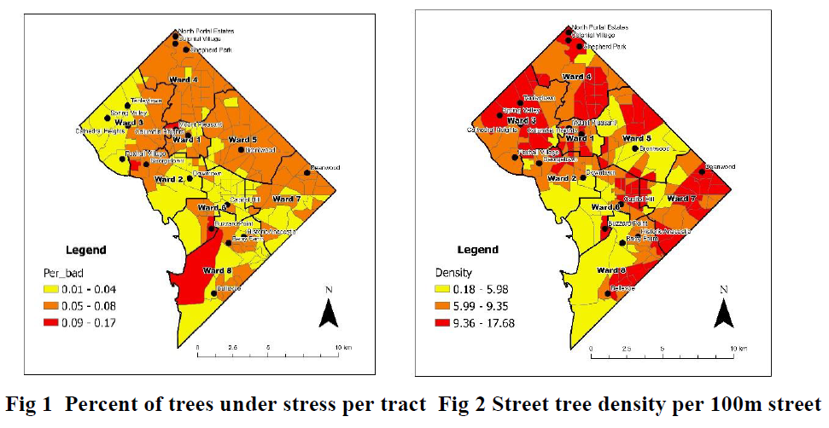
Urban Tree: Environment Justice
Fang et al., 2022 under review
Notes:
BOC: Binary offset carrier modulation

Slide 44
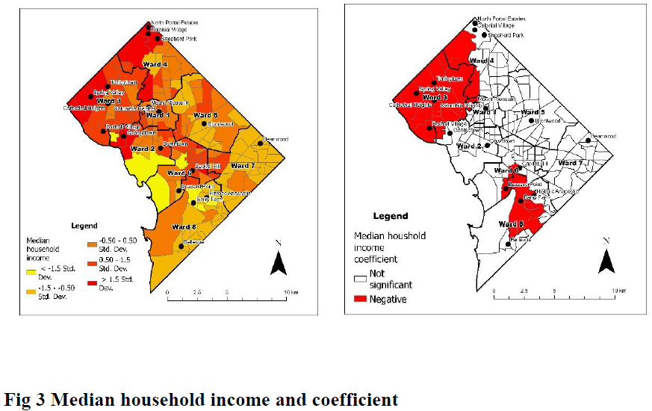
Urban Tree: Environment Justice
Fang et al., 2022 under review
Notes:
BOC: Binary offset carrier modulation

Slide 45
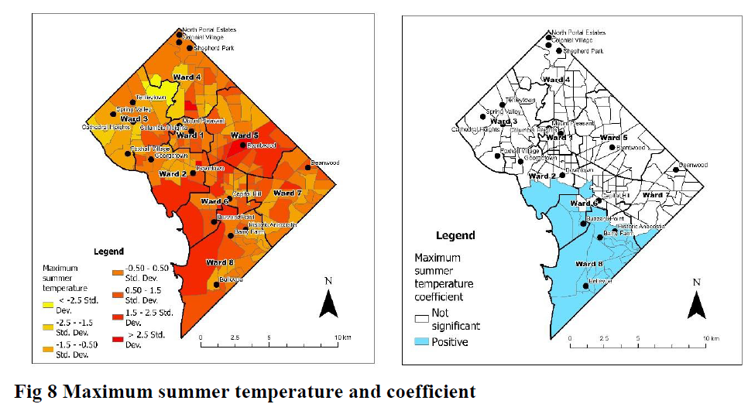
Urban Tree: Environment Justice
Fang et al., 2022 under review
Notes:
BOC: Binary offset carrier modulation

Slide 46
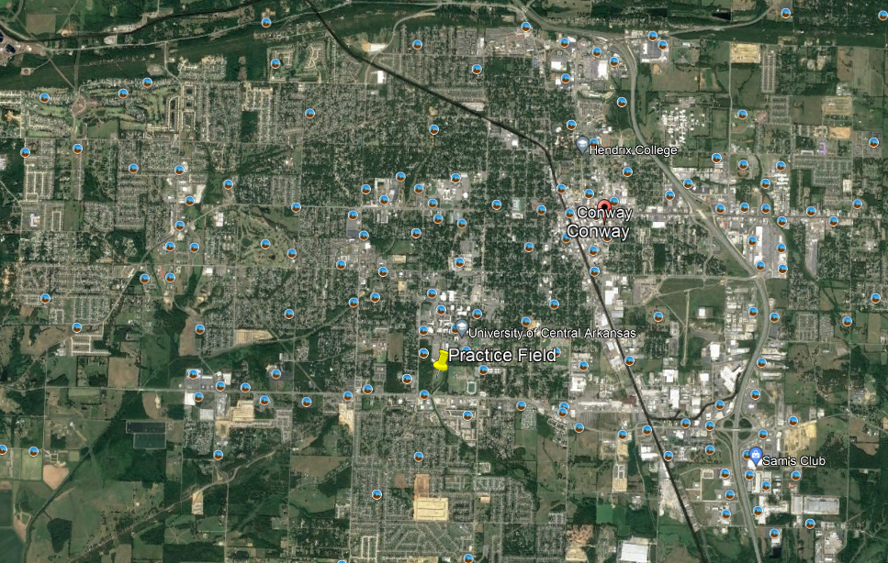
Urban Tree: Environment Justice
City of Conway
Notes:
BOC: Binary offset carrier modulation

Slide 47
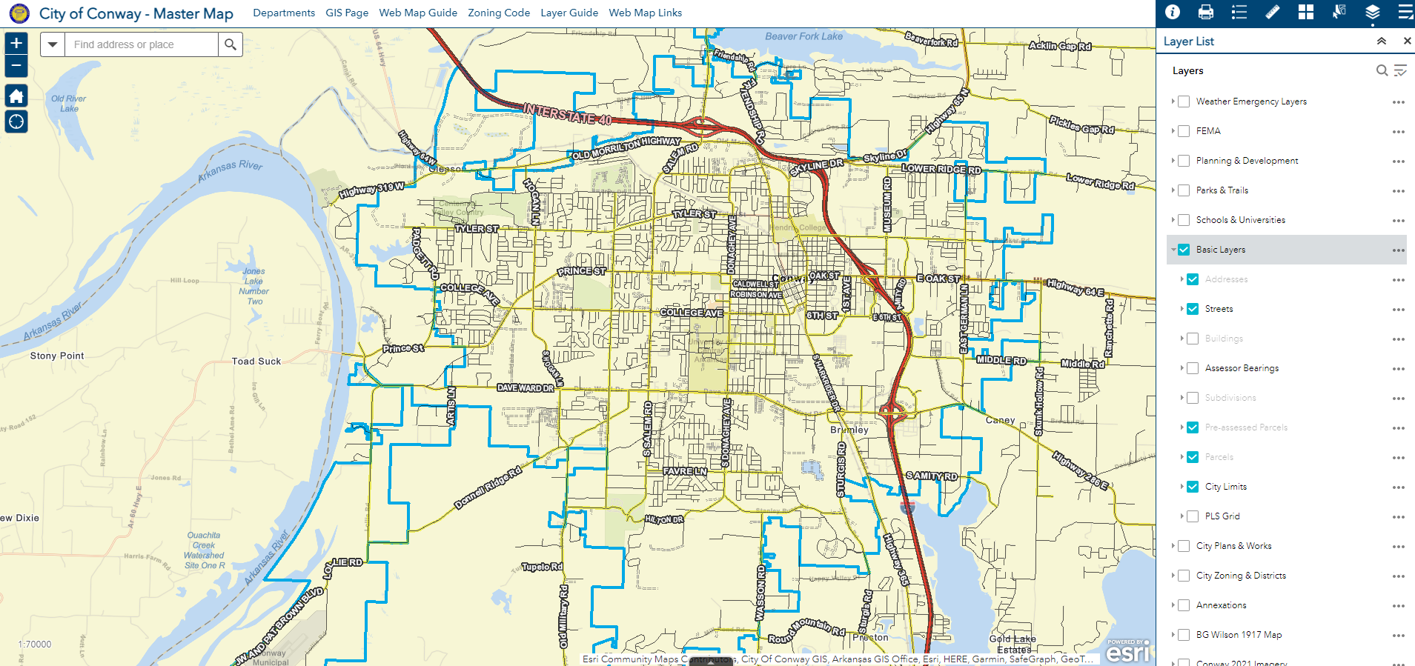
Urban Tree: Environment Justice
City of Conway
Notes:
BOC: Binary offset carrier modulation

Slide 48
Conway Tree Board
Annual Arbor Day Festival on November 5th from 11 am-1 pm in Laurel Park
With our Adopt A Tree activity where kids will be invited to pick a tree, measure, and make note of the tree attributes to earn their tree adoption certificate and tree journal. This would be a good activity that allows us to share the data we've collected while teaching children to do the same.
We can host our own table/ exhibit to share our own work to help educate attendees about the benefits of public trees in Conway.
Notes:
BOC: Binary offset carrier modulation

Slide 49
Thank you!

